Slide 1
Mid Day Meal Programme
Annual Work Plan
&
Budget [2020-21]
WEST BENGAL

Slide 2
ACTION TAKEN NOTE ON PAB 2019-20
 | Commitments of the State in the PAB- 2019-20 | Action taken
4.1 | Performance of PGI indicators | As per assessment score is 10 out of 10 in both the cases of Children taking MDM & MDM served days. All districts have been advised to maintain the highest Performance Grade Index consistently.
4.2 | More coverage of children in upper primary level. | During F.Y. 2018-19 coverage of Upper Primary children was 96.57% whereas during 2019-20 the percentage has improved to 96.87%. Special drive is being undertaken for further improvement.
4.3 | More coverage of Working Days | During 2018-19 days covered was 225 against PAB approval of 230 days. During 2019-20 we have managed to cover 230 days as approved in PAB meeting.
Cont..

Slide 3
ACTION TAKEN NOTE ON PAB 2019-20
 | Commitments of the State in the PAB- 2019-20 | Action taken
4.4 | Completion of 4136 Kitchen cum stores by Dec. 2019 | Construction of 81582 Kitchen cum stores has been completed out of sanctioned 81856 units. Sanctioned units of 274 during 2019-20 has been received and construction is in progress. Completed :- 81582 (Rs. 86587.61 lakh) In progress :- 274 (Rs. 786.38 lakh)
4.5 | 100% replacement of Kitchen Devices | 100% replacement has been done.
4.6 | School Health Programme | Regular Health Check up of children is carried out in the schools. Weekly IFA tablets, Deworming tablets are distributed with the help of Local BMOH.
Cont..

Slide 4
ACTION TAKEN NOTE ON PAB 2019-20
 | Commitments of the State in the PAB- 2019-20 | Action taken
4.7 | Training of Cook-cum-Helpers | Under UTKARSH BANGLA Programme in collaboration with Technical Education & Training Department, a pilot project for providing training to 17454 CCHs across the State have been completed successfully in the districts of GTA, South 24 Parganas, West Medinipur, Coochbehar & Jhargram.
4.8 | Data Entry on MIS-Web Portal | Data Entry on MIS-Web Portal is being done regularly.
4.9 | Status of implementation of AMS | AMS is running successfully. Satisfactory numbers of schools have started daily reporting.
Cont..

Slide 5
ACTION TAKEN NOTE – SLMC MEETING HELD ON 03.05.2019
 | Commitments of the State in the PAB- 2019-20 | Action taken
4.10 | Centralized kitchens in regard to provision of NFSA, 2013. | In West Bengal every school has the facility for providing meal to children at their respective schools only.
4.11 | Awareness generation activities | Awareness programme on MDM was observed in all districts by way of MDM Mela, Cooking competition, MDM Tableau on 26th January Republic Day etc.
4.12 | Social Audit | Social Audit is being carried out by the Education Supervisors engaged for field level monitoring purposes.
4.13 | Meeting of DLMC | Meeting of the DLMC is held regularly
Cont..

Slide 6
Initiatives taken during 2019-20
Training of Cook cum Helpers (CCHs)
State wide week long MDM Inspection Campaign
Food Testing by accredited laboratories
MDM Inspection Application
Publicity (Boards, flexes, graffiti in vernacular)
100 % LPG covered
8263 number of Dining Hall have been constructed
All CCHs and all DEOs under MDMS have been covered under Swasthya Sathi Scheme.
Safety : Mask, apron and head cover have been supplied to all the cook cum Helpers.
Rice & Potato Distribution due to COVID-19 situation

Slide 7
Automated Monitoring System (AMS)
Started since April, 2017.
Covering around 92% schools.
SMS based reporting platform.
Schools not running MDM can be spotted instantly & follow up action taken.

Slide 8
Coverage of MDM for 2019-20
Category | Eligible |  | Covered |  | % of coverage
 | Schools | Enrolment | Schools | Enrolment | Schools | Enrolment
Primary | 67131 | 7291512 | 67131 | 6804546 | 100% | 93.32%
Upper Primary | 16206 | 4244786 | 16206 | 4111755 | 100% | 96.87%
NCLP | 608 | 26167 | 608 | 26167 | 100% | 100.00%
TOTAL | 83945 | 11562465 | 83945 | 10942468 | 100% | 94.64%
Proposed Number of Days for 2020-21
Primary | Upper Primary | NCLP
230 days | 230 days | 312 days

Slide 9
Utilization of Fund & Food Grains
During 01.04.2019 to 31.03.2020
(Rs in Crore)
Components | Allocation for 2019-20 | O/B | Fund Received | Availability of fund | Fund Utilized | Unspent Balance as on 31.03.2020 | % of Utilization
Cooking Cost | 1337.70 | 84.19 | 1315.49 | 1399.68 | 1337.70 | 61.98 | 100%
Transportation cost | 41.83 | 5.46 | 34.96 | 40.42 | 31.43 | 8.99 | 75%
Management Monitoring & Evaluation (MME) | 29.15 | 0.00 | 29.15 | 29.15 | 29.15 | 0.00 | 100%
Honorarium to cook cum Helpers | 248.80 | 38.32 | 235.17 | 273.48 | 239.30 | 34.18 | 96%
Cost of Food grains | 89.64 | 21.82 | 64.79 | 86.61 | 67.35 | 19.26 | 75%
TOTAL | 1747.12 | 149.79 | 1679.56 | 1829.34 | 1704.93 | 124.41* | 98%
Component | Allocation for 2019-20 | O/B | Lifting | Availability of food grains | Rice Consumed (In MTs) | Unspent Balance as on 31.03.2020 | % of Consumption
Food grains/Rice (in MT) | 298807.49 | 10101.86 | 224512.84 | 234614.7 | 226536.61 | 8078.09 | 76%
* Unspent balance as on 31.03.2020: Central Rs. 33.94 Crore & State: Rs. 90.47 crore

Slide 10
INFRASTRUCTURE - DETAILS
Parameter | Proposal for 2020-21 | Status as on 31.03.2020 | % Covered
No. of schools | 83,945 | 83,935 (PAB) | 100%
No. of schools covered under MDM | 83,945 | 83,935 (PAB) | 100%
No. of students covered under MDM | 1,09,42,468 | 1,08,91,212 (PAB) | 95%
No. of schools with kitchen cum store | 36,958 (Repair) | 81,582 | 97%
No. of Kitchen Devices for replacement | 33,954 (Sanctioned in PAB 19-20,but fund not received) | 1,80,769 (Procurement – 90,855, Replacement – 89,914) | 100%
No. of schools with Dinning Halls | 6,004 (P – 4,531, UP – 1,473) | 8,263 (P – 6,141, UP – 2,122) | 10%
No. of schools with Fire Extinguisher | - | 57,996 | 69%
No. of Cook cum Helper engaged | 2,48,799 | 2,40,830 | 97%
No. of Education Supervisors | - | 731 | 100%
No. of schools with Kitchen Garden | 30,000 @ Rs. 5000/- | 9,716 | 12%
No. of schools with LPG | - | 83,945 | 100%

Slide 11
Budget Proposal for 2020-21
Rs. In Crore
SL | ITEMS |  | AWP&B 2019-20 |  | AWP&B 2020-21 | Remarks
No |  |  | Approved | Received including O/B | Proposed | 2019-20 | 2020-21
1 | Cooking Cost | Primary | 692.76 | 732.19 | 777.83 | Rs. 4.48 per meal | Rs. 4.97 per meal
 |  | U/ Pry. | 644.93 | 667.49 | 710.63 | Rs. 6.71 per meal | Rs. 7.45 per meal
2 | Transportation cost |  | 41.83 | 40.42 | 41.94 | Rs. 1400 per MT | Rs. 1400 per MT
3 | Management Monitoring & Evaluation (MME) |  | 29.15 | 29.15 | 31.69 | 2.7 % of Central Recurring Fund | 2.7 % of Central Recurring Fund
4 | Honorarium to cook cum helpers |  | 248.80 | 273.48 | 248.80 | Rs. 1000/- per cook per month (10 months) | Rs. 1000/- per cook per month (10 months)
5 | Cost of food grains |  | 89.64 | 86.61 | 89.88 | Rs. 3000 per MT | Rs. 3000 per MT
6 | Kitchen shed (New) |  | 7.86 | 7.86 | 0.00 | New: 274 | New: 0
 | Kitchen shed (Repair) |  | 11.69 | 11.69 | 36.96 | Repair: 11692 | Repair: 36958
7 | Kitchen device |  | 55.34 | 0.00 | 55.34 | Replacement - 33954 | Replacement - 33954
8 | Summer Vacation (one time) |  | NA | NA | 175.92 | NA | CC, TC & Cost of Rice
9 | Flexi fund |  | 80.62 | 0.00 | 81.62 | Additional Nutrition: 65.62 Cr + Kitchen Garden: 15 Cr | Additional Nutrition: 65.62 Cr + Kitchen Garden:15 Cr + Solar Panel: 1.00 Cr
TOTAL |  |  | 1902.63 | 1848.89 | 2250.61 | (Central Share – 1421.15 Cr. & State Share – 829.46 Cr.)
ADDITIONAL PROPOSAL
10 | Construction of Dining Hall |  |  |  | 194.35 | Primary (4531) @ Rs. 2.69 lakh & Upper Primary (1473) @ Rs. 4.92 lakh
11 | POST COVID-19 requirements |  |  |  | 221.12 | (Soap, Hand Sanitizer, Awareness Programme, Training of CCH, MASKS)
Grand Total |  |  |  |  | 2666.08*
6004 units
* Central Share – 1670.42 Cr. & State Share – 995.66 Cr.
Central + State Share
Only Central Share

Slide 12
MDM ISSUES
Remuneration of CCHs not revised since 2009. Rs. 600/- per month still being paid as Central Share. State Govt. is paying Rs. 400/- as State Share. We proposed revision of remuneration @ Rs. 2000/- per month, but not yet considered. Various associations are demanding revision of such remuneration
Considering remuneration of CCHs for 12 months instead of present 10 months.
Introduction of Mid Day Meal in preprimary, class IX and X, which is yet to be decided by GOI.

Slide 13
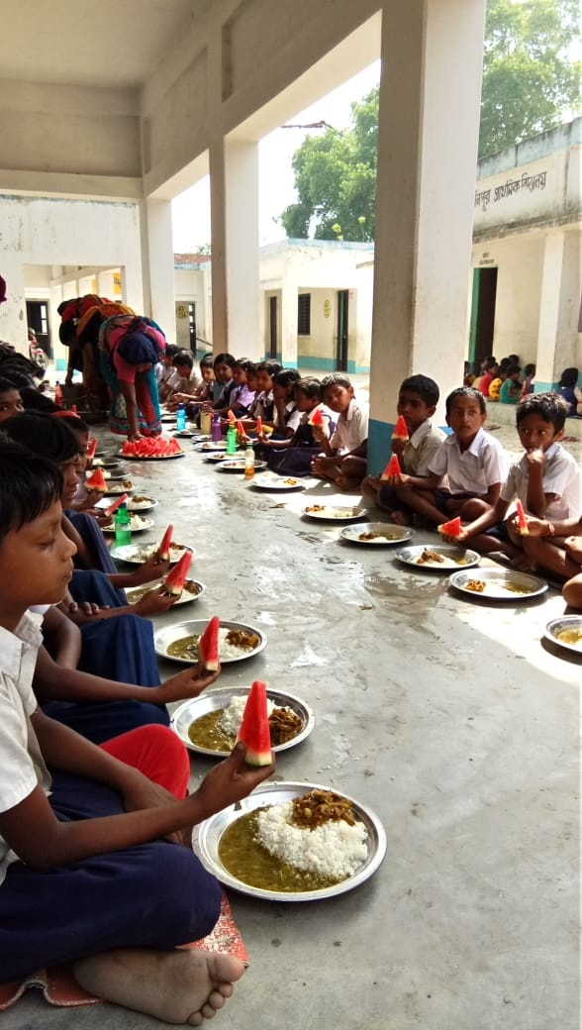
Glimpse
of
MDM

Slide 14
THANK YOU
Govt. of West Bengal
School Education Department
Mid Day Meal Section

Slide 16
Estimated Cost of each Kitchen Garden
1. | For the preparation of land two labour @ Rs. 350 each |  | Rs. 700/-
2. | Fencing | Materials | Rs. 1000/-
 |  | Labour | Rs. 700/-
3. | Purchase of saplings, water pipe, manure, spade etc |  | Rs. 1500/-
4. | Maintenance (Watering, repairing of fencing, removing weeds etc) |  | Rs. 1100/-
 | Total |  | Rs. 5000/-

Slide 17
Dining Hall:
A) So far Constructed:
Year | Primary @ Rs. 2.69 lakh | Upper Primary @ Rs. 4.92 lakh | TOTAL
2015-16 | 805 | 164 | 969
2017-18 | 358 | 73 | 431
2018-19 (MDM Budget) | 331 | 361 | 692
2018-19 (SED Budget) | 4647 | 1524 | 6171
TOTAL | 6141 | 2122 | 8263
B) Proposal:
Primary : 4531
6004
Upper Primary : 1473

Slide 18
Features – Swasthya Sathi Scheme
Basic health cover for secondary and tertiary care up to Rs. 5 lakh per annum per family.
Up to Rs 1.5 Lakh through Insurance Mode and beyond 1.5 lakh to 5 Lakh through Assurance Mode. Paperless, Cashless, Smart Card based.
There is no cap on the family size and Parents from both the Spouse are included. All dependent physically challenged persons in the family are also covered.
All pre-existing diseases are covered.
The entire premium is borne by the State Government and no contribution from the beneficiary.
Online Swathya Sathi Smart card is provided to each family on the day of Enrolment. Smart Card captures the details of the family members , Photographs, biometric, address, Mobile Number, SECC ID.

Slide 19
AMS – Reasons for not able to reach 100%
Server or SMS gateway or any other technical issue - NIC and NICSI-DELHI have the responsibility of solving the technical issues regarding server for AMS. It takes time to solve if such technical issues arises at any point of time.
HM/TIC absent - In case of any absence of HM/TIC whose numbers are actually registered in the portal, the other registered user don’t bother to send SMS in place of them.
Unwillingness of sending SMS - Every HM/TIC are requested several times to send SMS from school or even convey the message from home regarding MDM in case of any untoward incident. But in majority of the cases it is not done.
SSK / MSK school - The teachers registered in this category of school couldn't send SMS in exact format which results into failure of accepting the data into the AMS portal.
Zero enrolment School - The Districts couldn't deactivate the schools as they show cause of starting the schools in the coming months which finally doesn't get deactivated.
Not running MDM (including local Holiday) - In some pocket areas due to local holidays SMS is not being sent from such schools which hampers the AMS report at the end of the day.
Zero Network coverage zone - There are some handful of areas (part of some blocks of Sundarban areas, Tea Garden areas, GTA) where there exist some network related issues for which the SMS sent at times fail to reach the server within time.
Low enrolment Schools (less than 10) - 879 schools have enrolment less than 10. Here MDM cannot be served due to less fund availability or they cannot be merged with other schools due to different reasons.
N.B. A step may be taken to release MDM fund depending on AMS data up to school level which would result in achieving 100%.

Slide 20
PROPOSED BUDGET FOR FLEXI FUND – 2020-21
Rs. In Crore
Proposal | Central | State | Total
A. Additional Nutrition for providing Egg @ Rs. 5/- for 55 days for 23.86 lakh children of 7 districts of Jungle Mahal, Sundarban & distressed Tea Garden Areas. | 39.37 | 26.25 | 65.62
B. Development of kitchen garden of 30000 schools @ Rs. 5000/- | 9.00 | 6.00 | 15.00
C. Setting of Solar panel in 100 schools @ Rs. 1 lakh per school | 0.60 | 0.40 | 1.00
Grand Total | 48.97 | 32.65 | 81.62
N.B. Flexi Fund:- Flexibility to the States for utilizing 5% of their Annual Work Plan & Budget for new interventions under National Programme of Mid-Day-Meal in schools.

Slide 21
Additional Proposal – 2020-21
Construction of Dining Hall
Primary Schools | Fund required @ 2.69 lakh per unit | Upper Primary Schools | Fund required @ 4.92 lakh per unit | Total (In units) | Total Fund Required (In Lakhs)
4531 | 12188.39 | 1473 | 7247.16 | 6004 | 19435.55
B) POST COVID-19 – Requirements (Synopsis)
ITEMS | SCALE | Amount (Rs. In Lakhs)
Soap | One soap for 25 students for 6 days | 3358.62
Hand Sanitizer | One 100 ML for 15 students for 6 days | 11189.48
Awareness Programme | Per school: Pry@ Rs. 500/-; Up. Pry & NCLP @ Rs. 750/- per month | 5541.12
Training to CCH | One meeting (100 CCH) per month @ Rs. 1000/- | 289.00
MASK | 2 unit per month for one CCH | 1733.98
TOAL |  | 22112.18

Slide 22
Mid Day Meal Programme
A short video on MDM

Slide 23
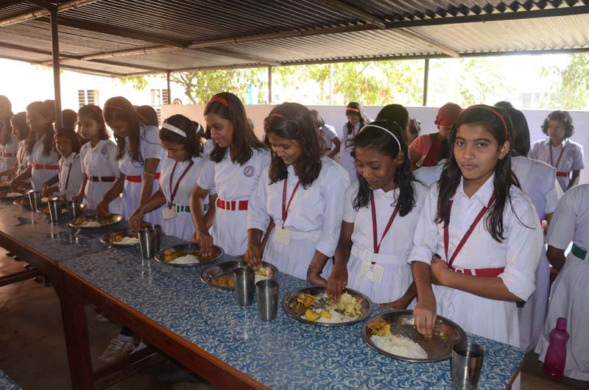
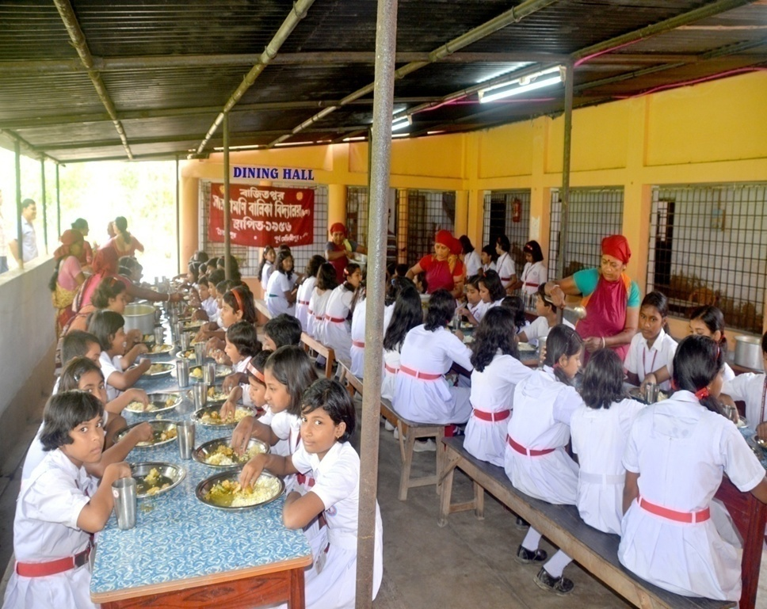
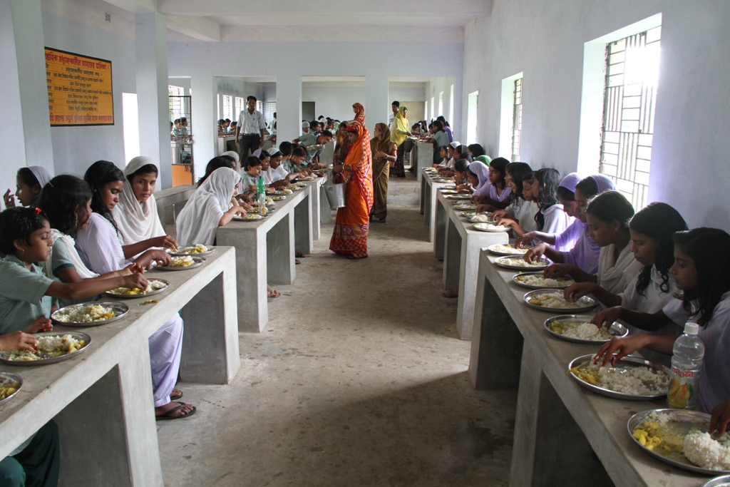
Mid Day Meal Programme
STUDENTS TAKING MDM IN DINING HALLS
Saradamoni Balika Vidyalaya, Bajitpur, Purba Medinipur
Dining at Dr Jakir Hossain High Madrasah under Tehatta-1 Block, Nadia

Slide 24
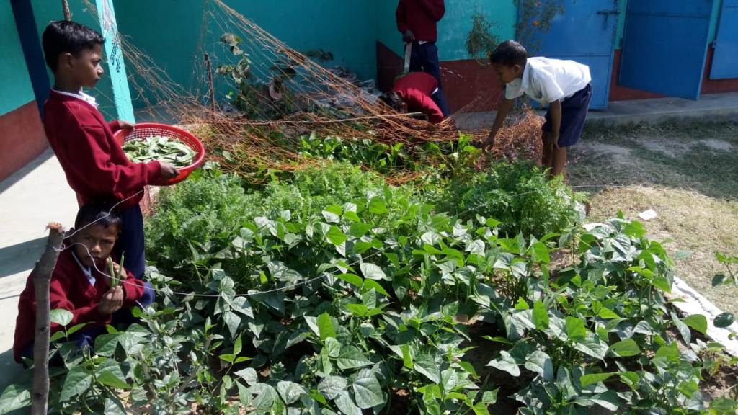
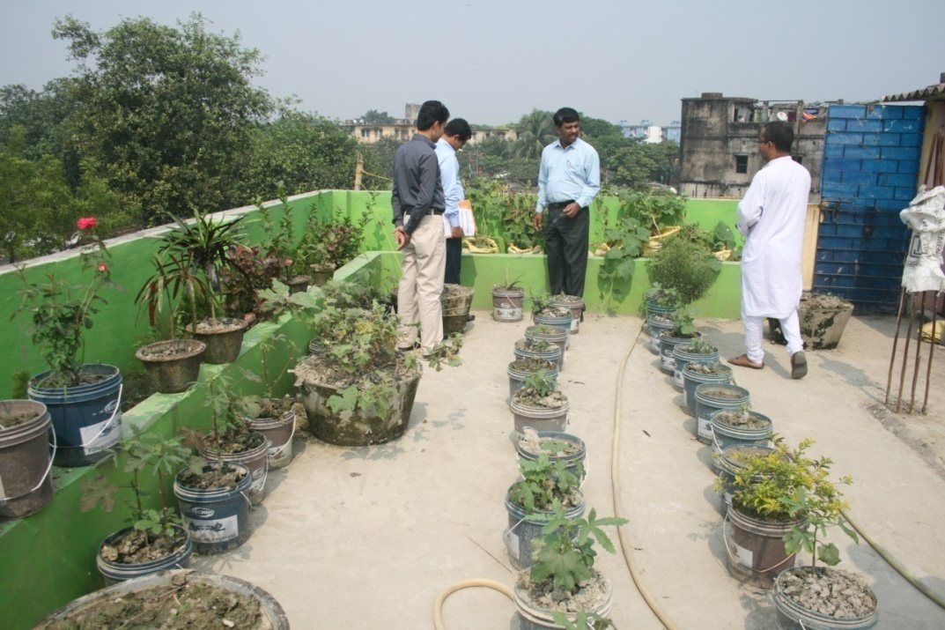
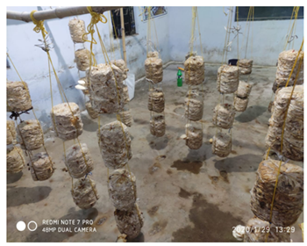
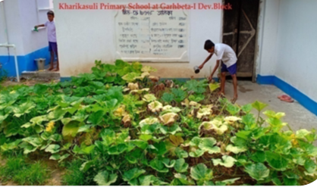
Mid Day Meal Programme
KITCHEN GARDEN
Kitchen Garden in a school , Paschim Bardhaman
Roof top kitchen garden Boinchtala Upendranath Prathamik Vidyalaya
Mushroom cultivation in a school, Birbhum
Kharikasuli Primary School, Garhbeta-I Block, Paschim Medinipur

Slide 25
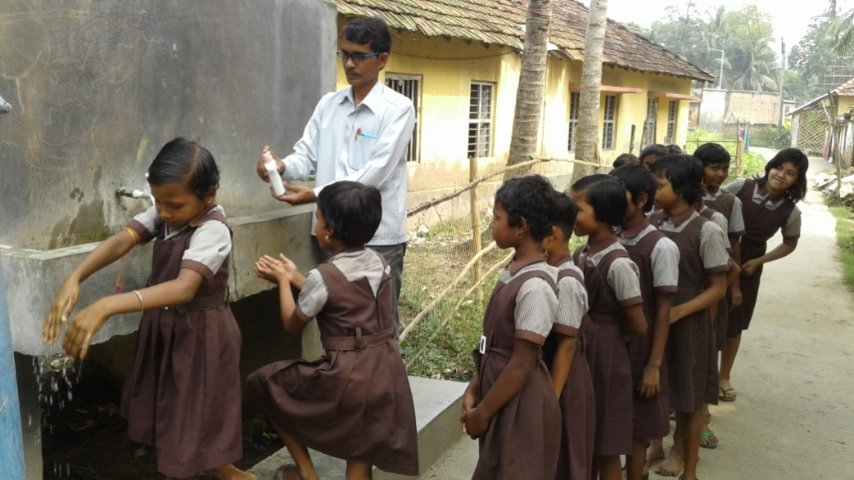
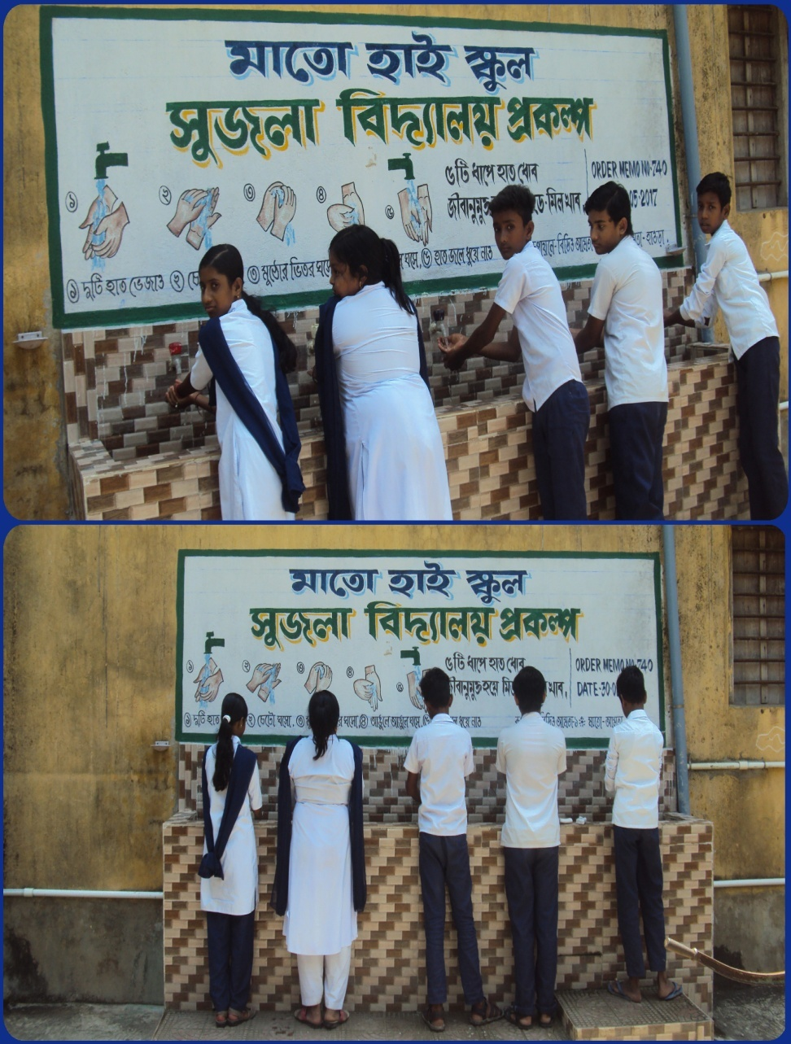
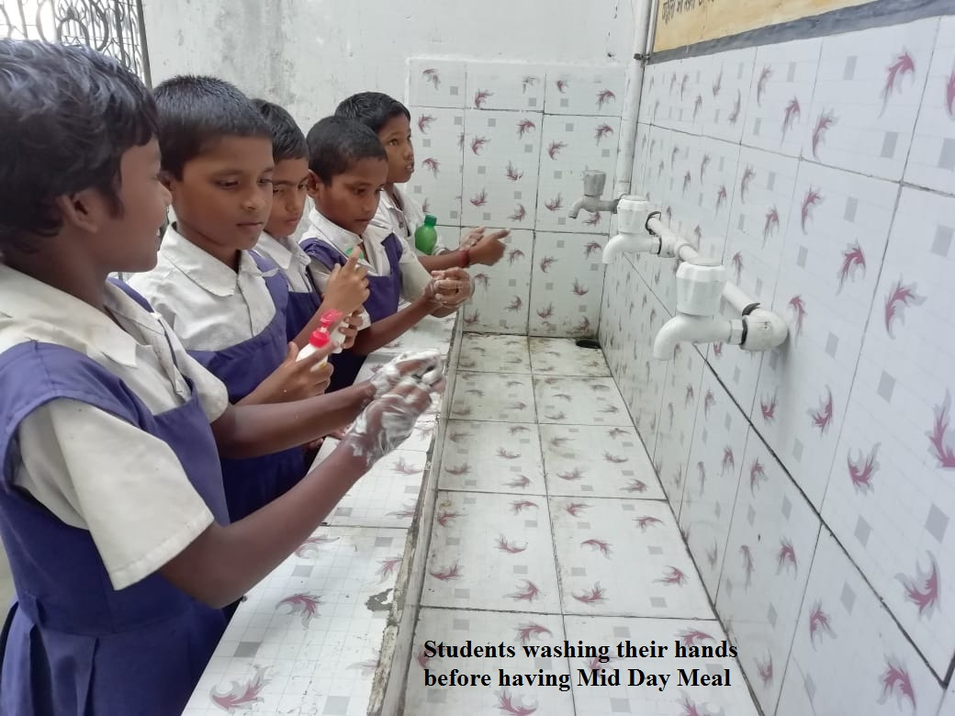
Mid Day Meal Programme
HAND WASHING
CHUNAKHALI SUHAS SMRITY PRY SCHOOL,Nandakumar Block, Purba Medinipur
Sujala Vidyalaya- Mato High School, Howrah

Slide 26
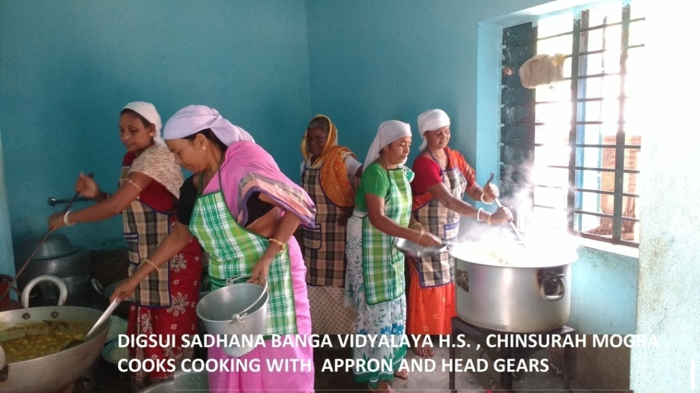
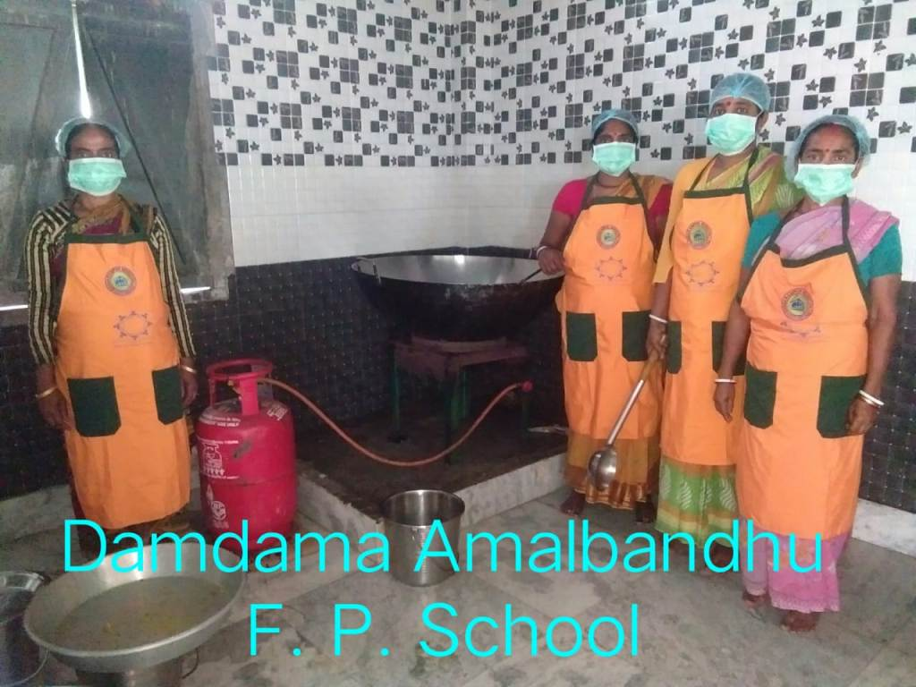
Mid Day Meal Programme
Cook cum helpers cooking with Appron and Head Gears
Dakshin Dinajpur

Slide 27
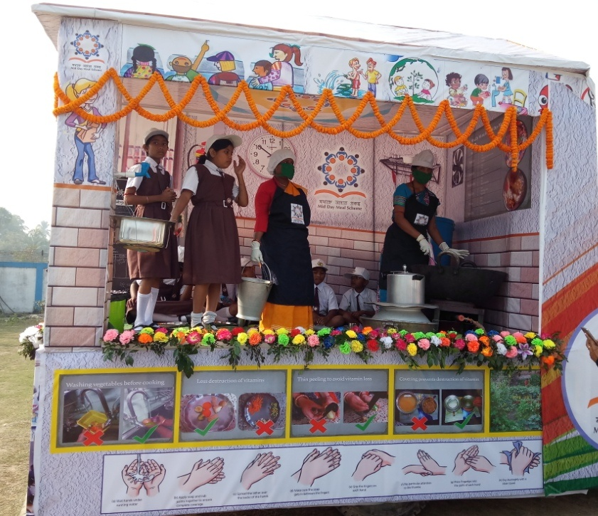
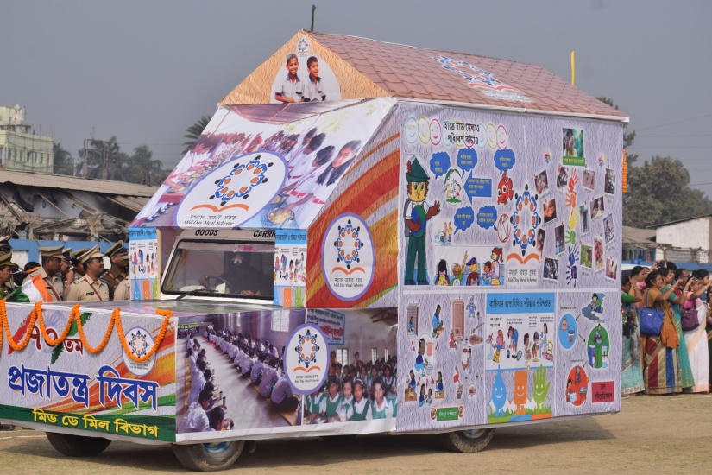
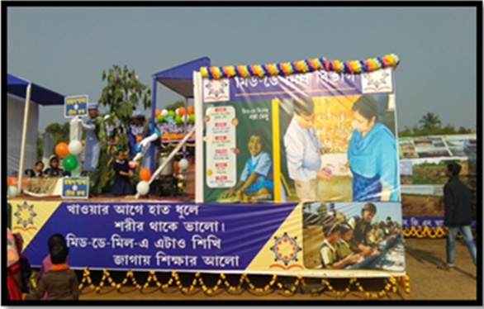
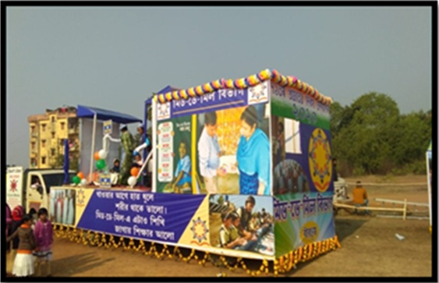
Mid Day Meal Programme
MDM Awareness Campaign on 26th January, Birbhum
MDM Awareness Campaign on 26th January, East Medinipur

Slide 28
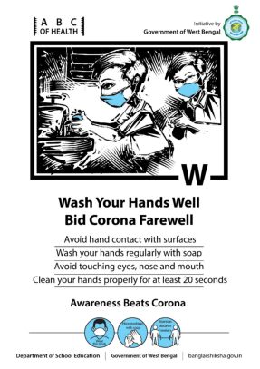
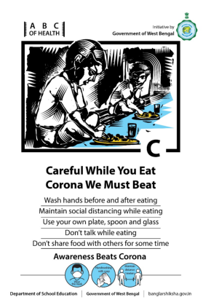
Students Awareness Poster :-
LINK to PDF : (Students Awareness Poster)

Slide 29
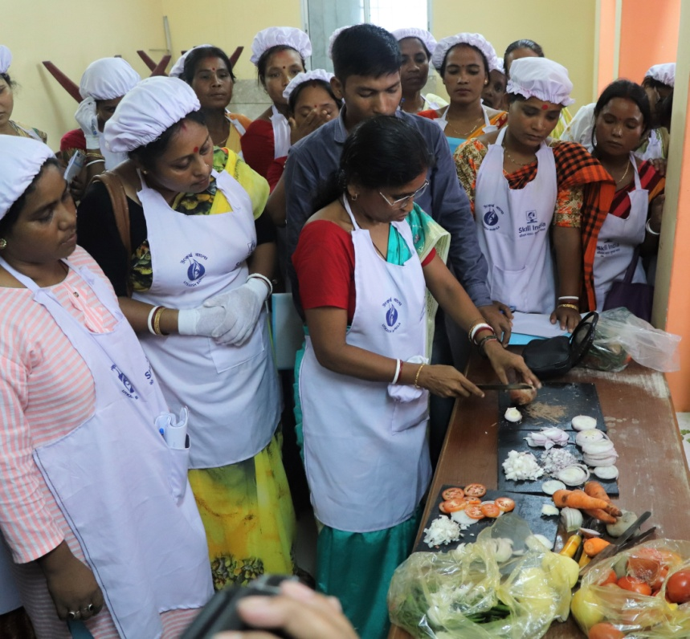
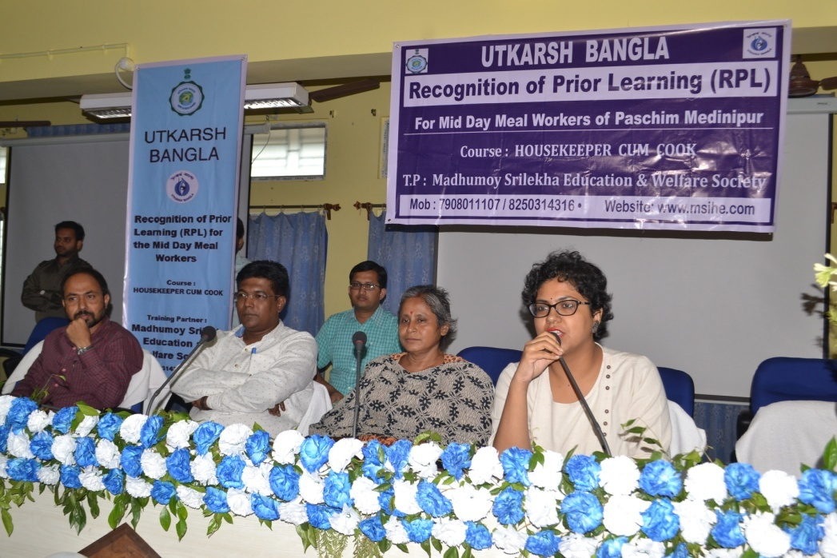
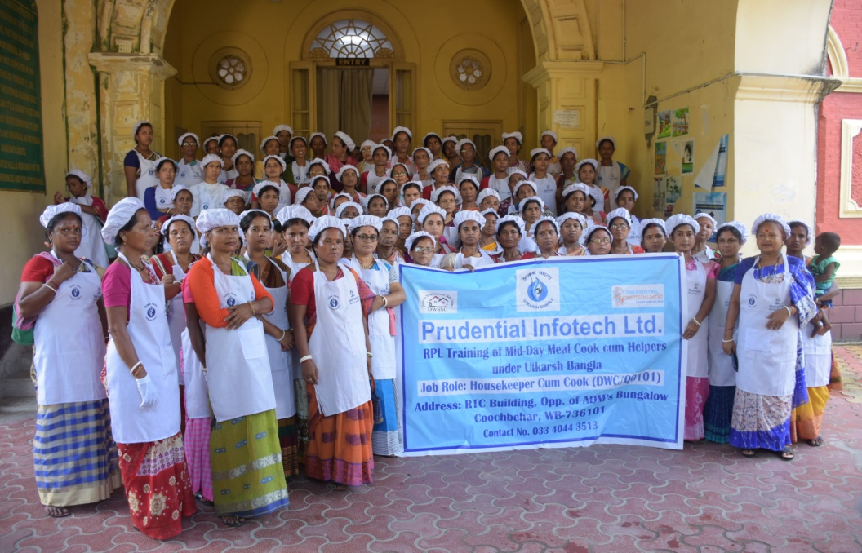
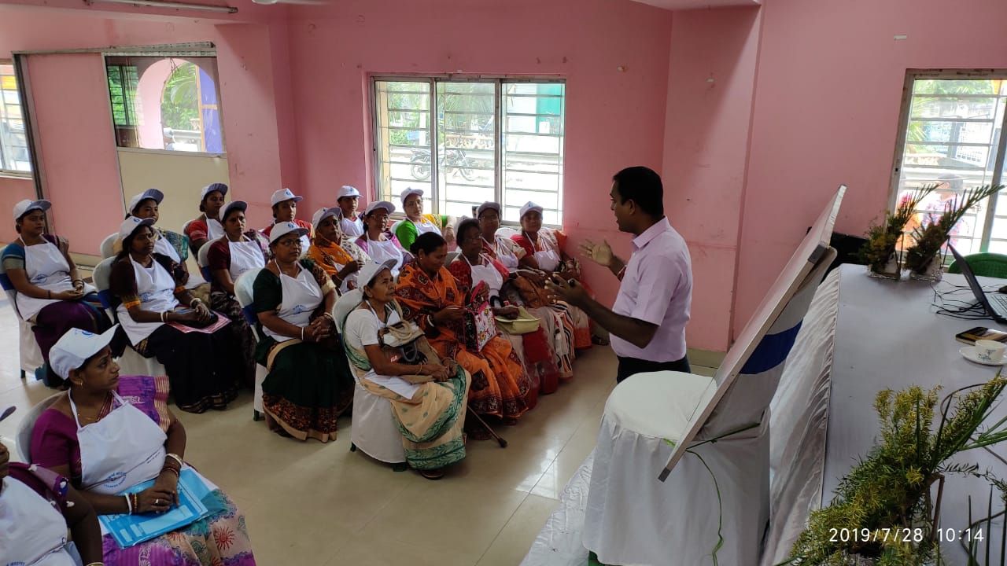
Mid Day Meal Programme
Training of Cook cum helpers
Paschim Medinipur
Cooch Behar
South 24 Parganas
Cooch Behar

Slide 30
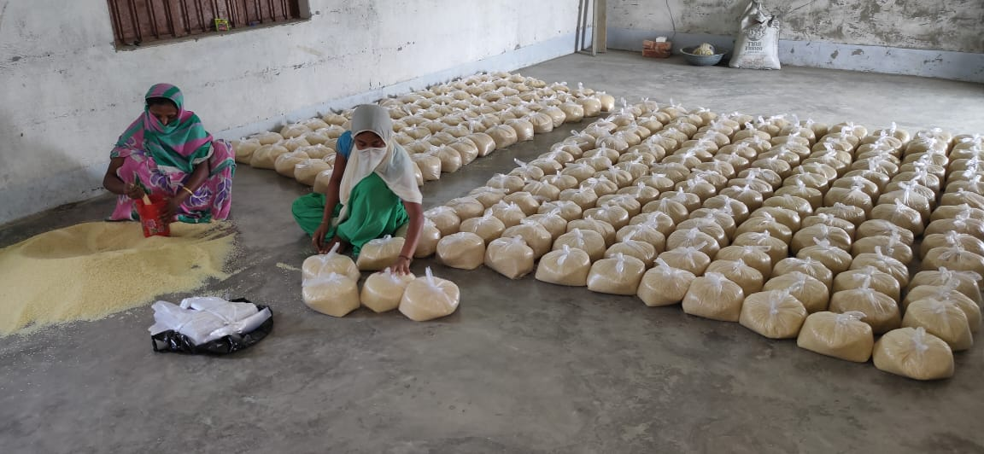
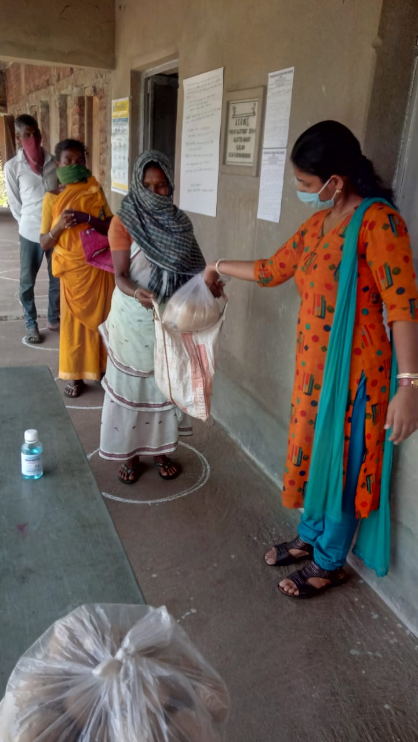
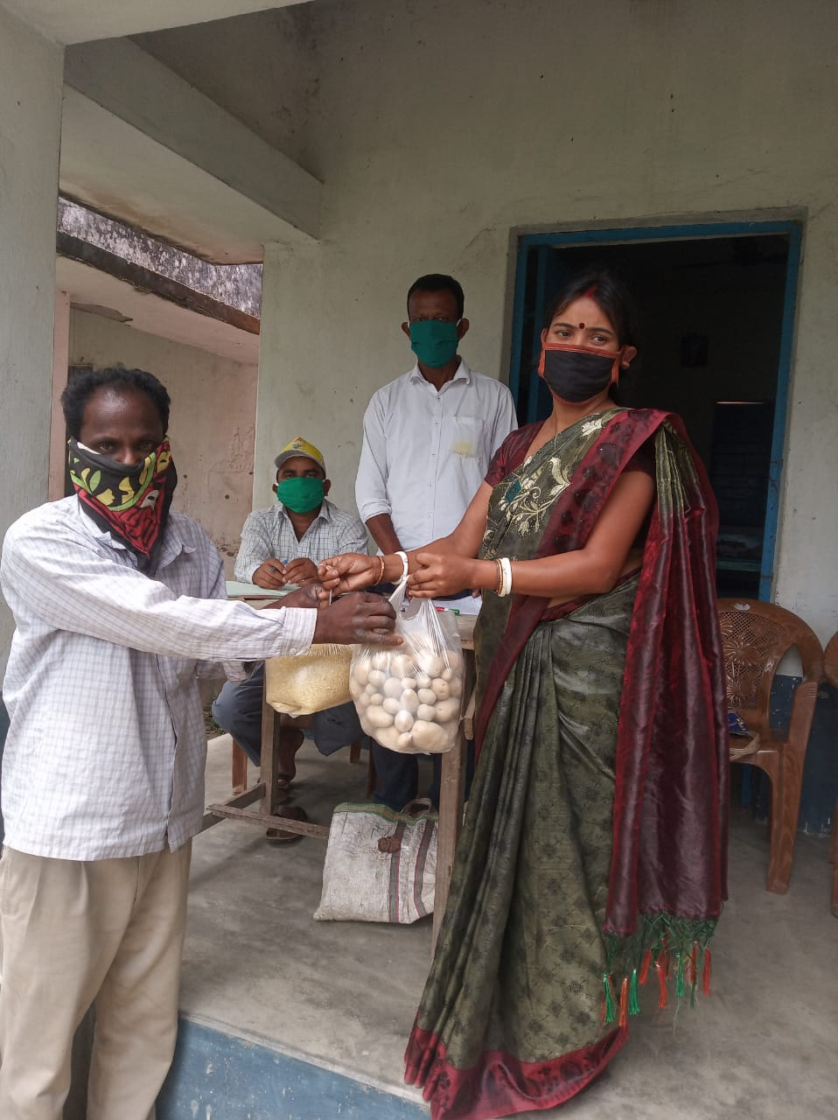
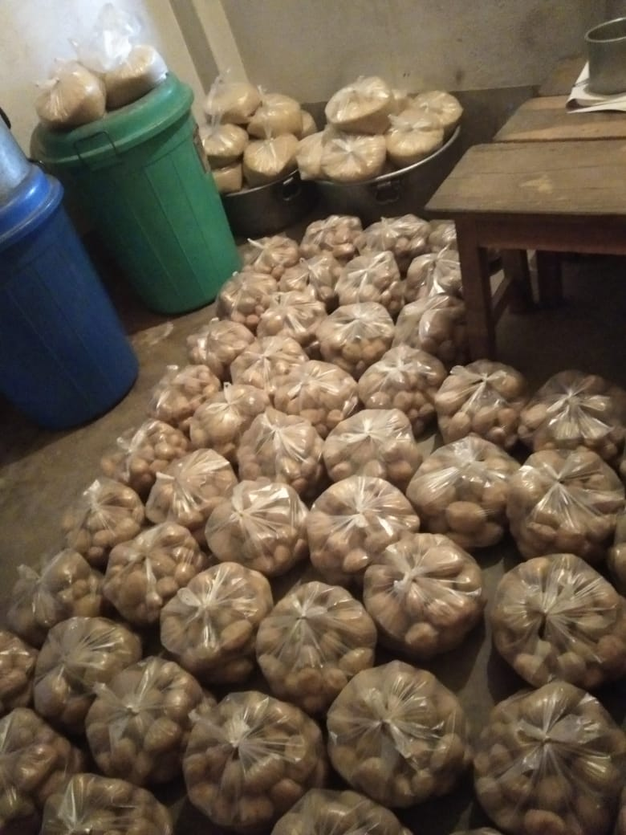
Mid Day Meal Programme
Rice and Potato distribution to Guardians of students during COVID-19 situation

Slide 31
THANK YOU
Govt. of West Bengal
School Education Department
Mid Day Meal Section

